Slide 1
ASER PAKISTAN
A Citizen Led Initiative
Punjab Launch
February10, 2014
Lahore

Slide 2
ASER PARTNERS
10,000 Volunteers – Citizens – Youth !

Slide 3
ASER PAKISTAN 2010-2015
Citizen led large scale national household survey (3-16 years).
Quality of education in rural and some urban areas (5-16 years).
Seeks to provide evidence on learning and access.
Influence National & Provincial policy and actions for Right To Education (RTE) Article 25-A.
Provides information for tracking MDG/EFA trends and targets up to 2015.
Influencing goal setting for Post-2015 agenda.

Slide 4
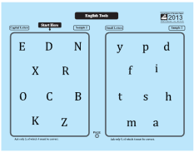
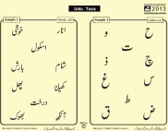
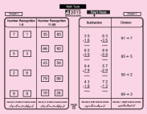
ASER ASSESSMENT TOOLS
ASER Assessment tools :
1. LEARNING
Reading (Urdu/Sindhi/Pashto)
Arithmetic
English
Assessments are based on Class II level curriculum for English & Urdu/Sindhi/Pashto and Class III level for Arithmetic.
HOUSEHOLD SURVEY
SCHOOL SURVEY – GOVERNMENT & PRIVATE

Slide 5
Scale of the Survey
36
Districts (Rural)
4
Districts (Urban*)
62,634 Children (3-16 Years) | 1,928 Schools | 1,141 Villages |22,704 Households
*Urban: Rahim Yar Khan, Multan, Faisalabad, Lahore.

Slide 6
FINDINGS

Slide 7
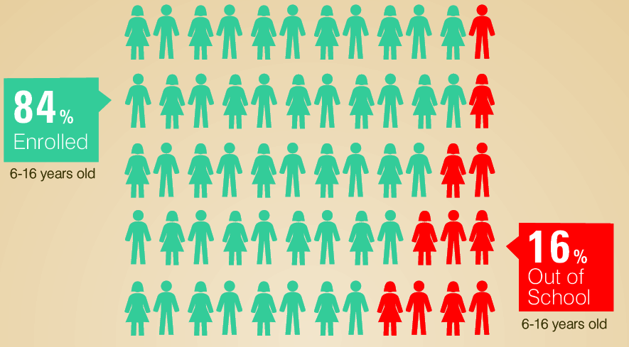
Enrollment (6-16 Years)
RURAL

Slide 8
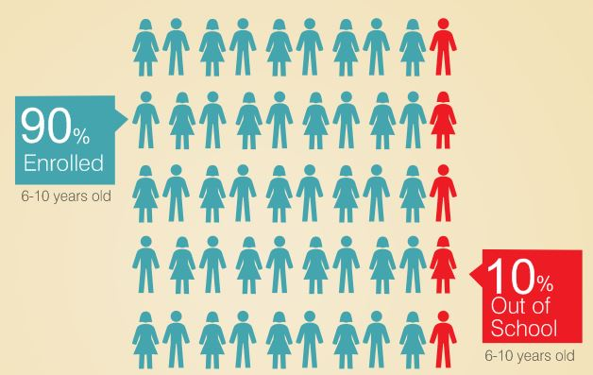
Enrollment (6-10 Years)
RURAL

Slide 9
Out of school children (6-16 Years)
RURAL
District wise map showing % children
who are not in school

Slide 10
Out of school children – Punjab (6-16 Years)
RURAL
Top 5 districts | % of OOSC
1. Gujrat | 5.1
2. Narowal | 5.9
3. Gujranwala | 6.6
4. Chakwal | 6.7
5. Rawalpindi | 7.3
Bottom 5 districts | % of OOSC
Rajanpur | 40.7
2. Dera Ghazi Khan | 29.8
3. Chiniot | 27.3
4. Rahim Yar Khan | 27.2
5. Bahawalpur | 23.8

Slide 11
Out of school children (6-16 Years)
RURAL
Province wise map showing % children
who are not in school

Slide 12
Enrollment (6-16 Years)
URBAN
93%
Enrolled
7%
Out of School

Slide 13
Gender Comparison
Out of School Children (6-16 years)
RURAL
The proportion of out of school children (girls & boys) has remained the same.

Slide 14
Class Wise Enrollment
RURAL
Enrollment decreases as class level increases

Slide 15
QUALITY

Slide 16
66% children in class 5 can read Story in Urdu.
LEARNING LEVELS
URDU
RURAL

Slide 17
LEARNING LEVELS
URDU
RURAL
Learning levels remain poor: 34% of the children from Class 5 cannot read Class 2 level story almost similar to 2012.

Slide 18
(Class 5)
District wise map showing % children
who can read story (Class 2 level)
LEARNING LEVELS
URDU
RURAL

Slide 19
(Class 5)
Province wise map showing % children
who can read story (Class 2 level)
LEARNING LEVELS
URDU/SINDHI/PASHTO
RURAL

Slide 20
62% children in class 5 can read Sentences in English
LEARNING LEVELS
ENGLISH
RURAL

Slide 21
LEARNING LEVELS
ENGLISH
RURAL
Very low improvement over the years: 38% of Class 5 children cannot read sentence in English (Class 2 level) in 2013 compared to 39% in 2012.

Slide 22
(Class 5)
District wise map showing % children
who can read sentences (Class 2 level)
LEARNING LEVELS
ENGLISH
RURAL

Slide 23
(Class 5)
Province wise map showing % children
who can read sentences (Class 2 level)
LEARNING LEVELS
ENGLISH
RURAL

Slide 24
56% children in class 5 can do 2-digit division
LEARNING LEVELS
ARITHMETIC
RURAL

Slide 25
LEARNING LEVELS
ARITHMETIC
RURAL
Arithmetic learning levels remain the same: 44% of class 5 children cannot do division in 2013 & 2012.

Slide 26
District wise map showing % children
who can do division (Class 3 level)
LEARNING LEVELS
ARITHMETIC
RURAL
(Class 5)

Slide 27
Province wise map showing % children
who can do division (Class 3 level)
LEARNING LEVELS
ARITHMETIC
RURAL
(Class 5)

Slide 28
LEARNING LEVELS
BY GENDER (5-16 YEARS)
RURAL
Girls continue to lag behind boys in language and arithmetic competencies.

Slide 29
LEARNING LEVELS
Learning levels of children enrolled in private schools are better
TYPE OF SCHOOL
63% of children in government schools (Class 5) while 71% of children in private schools can read a story in Urdu.
58% of children in government schools while 70% of children in private schools (Class 5) can read sentences in English.
54% of children in government schools while 60% of children in private schools (Class 5) can do division. .

Slide 30
ADDITIONAL LEARNING SUPPORT
PAID TUITION
Rural
Urban
Children in urban centers are more inclined to take paid tuition

Slide 31
LEARNING LEVELS
OUT OF SCHOOL CHILDREN
RURAL
More than 40% out of school children are at more than ‘beginner’ level

Slide 32
LEARNING LEVELS
URBAN
Learning levels of children living in urban centers are better compared to rural counter parts.

Slide 33
RURAL & URBAN COMPARISON
*Learning levels are taken for children enrolled in Class 5

Slide 34
School Attendance & Facilities

Slide 35
ATTENDANCE
TEACHER
RURAL
Teacher attendance in government primary schools is better compared to private primary schools.
Teacher attendance trends have slightly improved as compared to 2012.

Slide 36
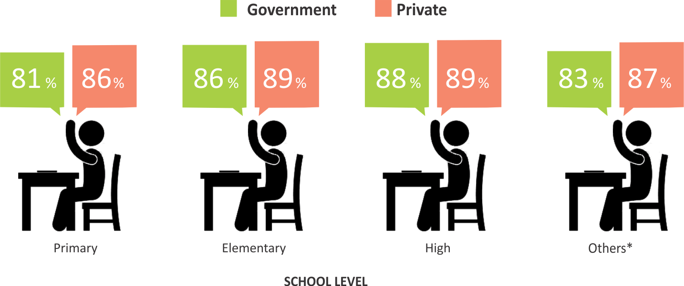
ATTENDANCE
CHILDREN
RURAL
86%
86%
89%
88%
90%
88%
92%
88%
Overall children attendance is better in government schools

Slide 37
MULTI-GRADE TEACHING
Rural
Urban
Multi-grade teaching is higher in rural areas of Punjab. However, the difference is not much.

Slide 38
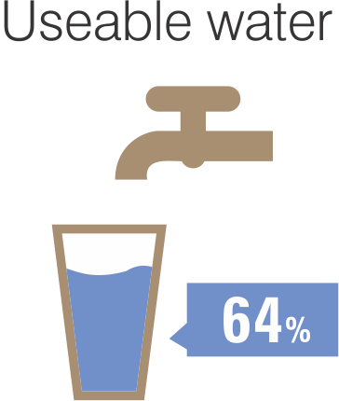
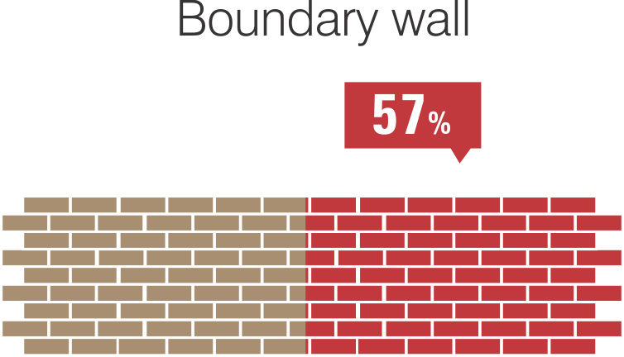
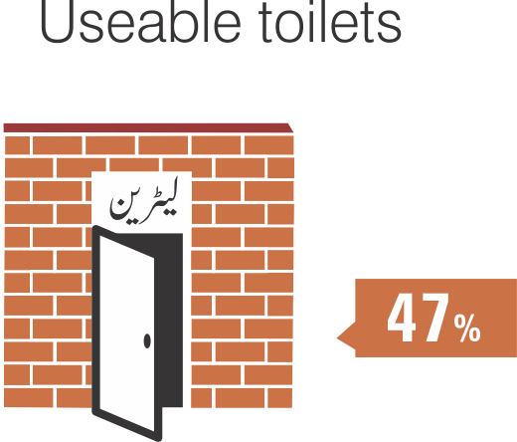
BASIC FACILITIES
GOVERNMENT PRIMARY SCHOOL
RURAL
80%
95%
86%
Basic facilities in schools are still missing: 5% government primary schools do not have drinkable water facility, 20% do not have complete boundary walls and 14% do not have usable toilets.

Slide 39
Dissemination with a Difference!
Mobilizing a Citizens’ Movement for Quality Education in Pakistan

Slide 40
ASER Dissemination
Segmented Groups for
Accountability & Action
ASER Baithaks/Jirgas/Katcheries (village/area gatherings) stakeholders: parents, communities, children, teachers . teachers, parents, children, government field officials to demand ACTION FOR IMPROVEMENT!
Teacher Unions & Associations Baithaks
District/Provincial/Federal Education & Literacy Departments
(Local, District, Provincial, National & International)
Youth Groups - mobilizing Ambassadors for Learning
Parliamentarians – politicians knocking on the doors in their constituencies
Judiciary & Judicial Academies- evidence backed judgments on 25 A
Academia/University /Research Groups - Pakistan & Abroad
Civil Society Organizations – nationwide- globally
Social Media
Media – Media – Media !

Slide 41
Supporters of ASER Pakistan

Slide 42
Thank You

